Slide 1



Multi-Trait and Industry System - Functional Assessment
Value Capture Transformation
February 6th, 2019

Slide 2
Agenda
Introduction to the Assessment
Vision for the Future
Master Data, Parameters and Permissions
Multiplication
Sales
POD
Legally Saved Seeds

Slide 3
Introduction
Multi-Trait and Industry System Assessment

Slide 4
Introduction to the Assessment
This assessment presents the functional assumptions and required changes to enable ITS (Brazil`s Value Capture system) to:
Support to multiple traits (referred as Multi-Trait scenario).
Support to other trait owners (referred as Industry System).
This was an intermediate level, non-exhaustive analysis.
Further refinement will be done as part of our agile methodology, as we prioritize and start grooming each one of the requirements / changes.

Slide 5
Vision for the Future
Soybean Industry Ecosystem

Slide 6

Soybean Industry Ecosystem - Platform Vision
Vision: Create an ecosystem around ITS (Industry System) that sustains technology value capture processes for Trait Owners in the Agriculture Industry along with leveraging productivity and innovative solutions for Growers and Partners.
3- API Gateway & App Store
Enable the development of B2B integrations
and independent apps that leverage productivity and innovative solutions
Scope: Productivity and Innovation.
2- Trait Owner Systems
Decouple Trait Owner exclusive
features from the Industry System and protect company confidential data.
Scope: Master Data Flows, Billing, Revenue Recognition, Marketing Programs.
1- Value Capture Industry System (branded as ITS)
Enable Trait Owners to capture the value of soybean technology and provide a standard U/X for partners.
Scope: Multiplication, Sales, Legally Saved Seeds, POD.

Slide 7
Master Data, Parameters and Permissions
Multi-Trait and Industry System Assessment

Slide 8
Master Data - Trait and Trait Owner
AS-IS x TO-BE
AS-IS: one trait connected to one trait owner
TO-BE: multiple trait owners with multiple traits
“NOT SUPPORTED”: a trait connected to two different trait owners
Bayer
Bayer
Trait Owner 2
Trait Owner 3
Trait Owner 1
Trait Owner 2
Intacta
Intacta
Xtend
Trait 3
Trait 4
Trait 5
Trait 6

Slide 9
Master Data - Trait and Trait Owner
AS-IS

Slide 10
Master Data - Trait and Trait Owner
TO-BE (NEAR FUTURE)

Slide 11
Master Data - Trait and Trait Owner
TO BE

Slide 12




Master Data - Partners and Contracts
AS-IS
One Trait Owner
RTV Request
Customer Service
Accepted?
Yes
SAP ERP
ITS
Partner Access
No
Partner and Contract created in Bayer’s ERP by Backoffice teams
Partner and Contract data integrated into ITS
Return to RTV in case of not satisfying acceptance criteria

Slide 13
Master Data - Partners and Contracts
TO-BE
Multiple Trait Owners TO BE 1
RTV Request
Customer Service
Accepted?
Yes
TO’s ERP
Trait Owner System
ITS Industry System
Partner Access
Contract per trait, function and season.
No
Partner and Contract created in Trait Owner’s ERP by their backoffice teams
Integrated into the VC system of each Trait Owner
Integrated into ITS Industry System
(Multipliers and Dealers)
OR
Return to RTV in case of not satisfying acceptance criteria
Multiple Trait Owners TO BE 2
Yes
RTV Request
ITS Industry System
Trait Owner System
Accepted?
TO’s ERP
Trait Owner System
Partner Access
(PODs)
Partner and Contract created in ITS Industry System by the Consortium
Integrated into the VC system of each Trait Owner. Submitted to the master data teams of the Trait Owner.
Partner and Contract created in Trait Owner’s ERP by their backoffice teams
ERPs will send back to the VC systems the ERP codes like partner number and contract number (which will be required for billing, revenue recognition and accrual processes).
No
Return to Consortium in case of not satisfying acceptance criteria

Slide 14
Master Data - Partners and Permissions
TO-BE

Slide 15
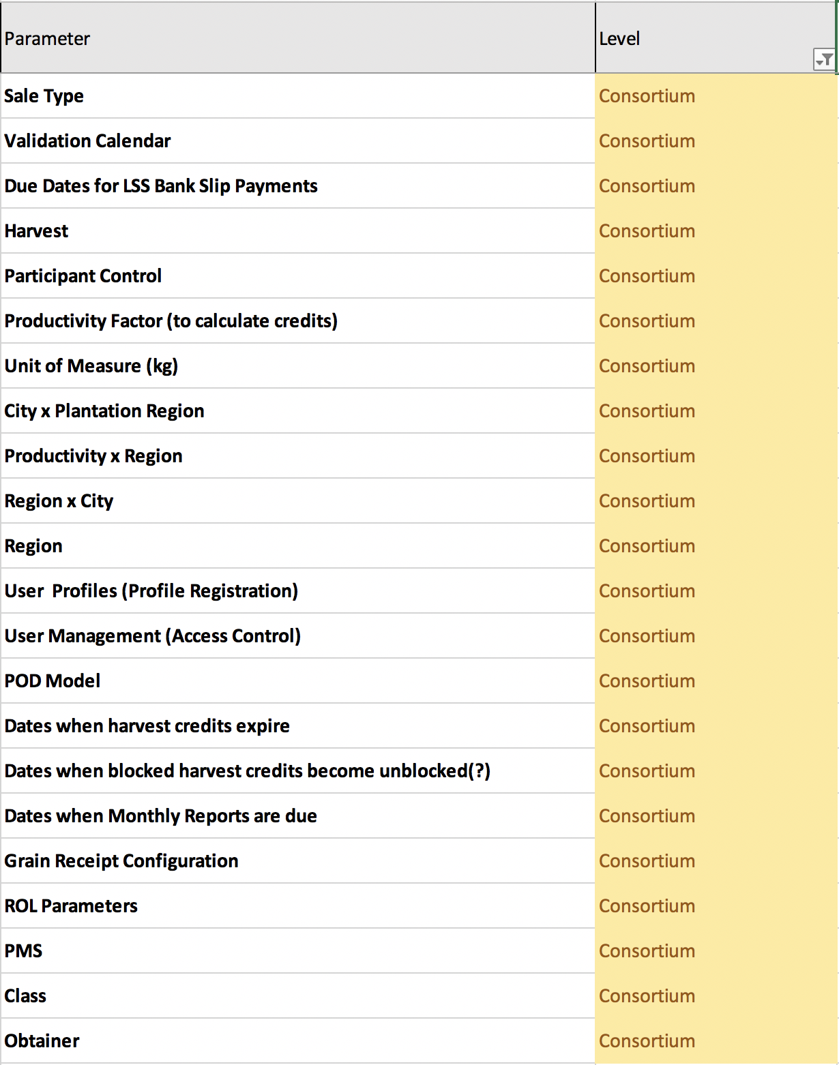
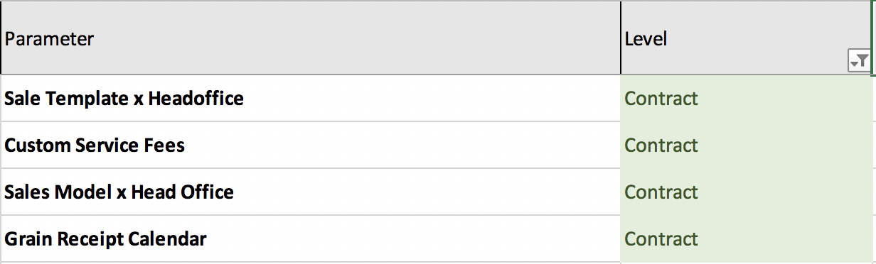
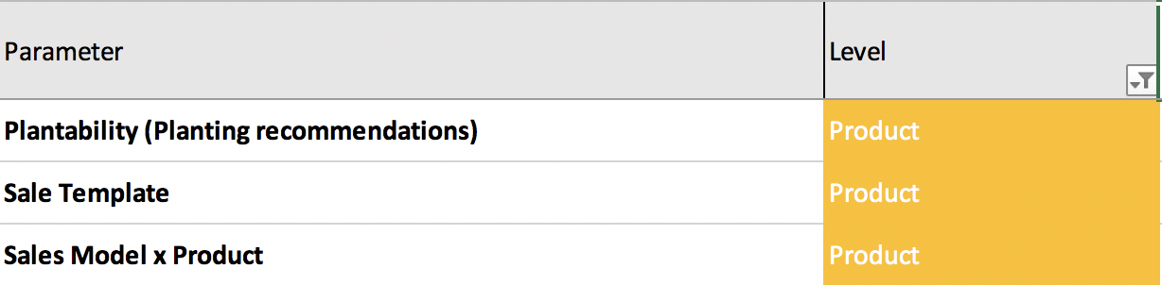
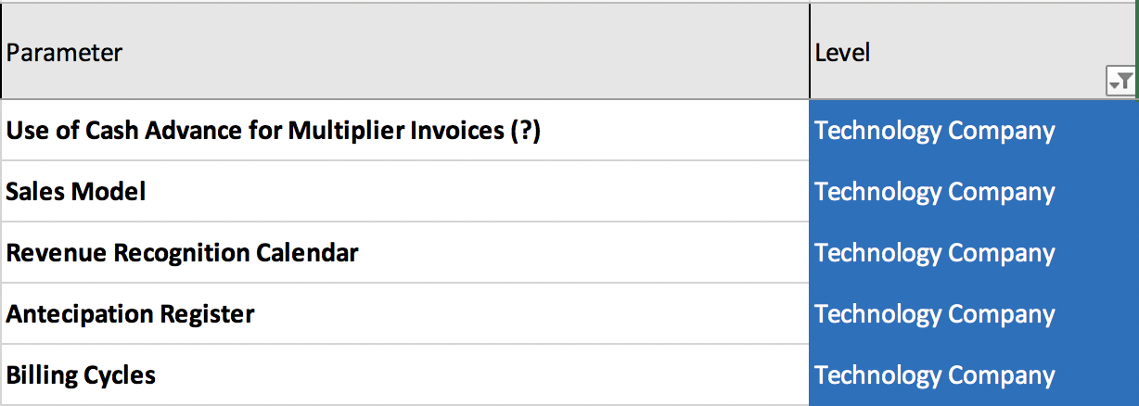
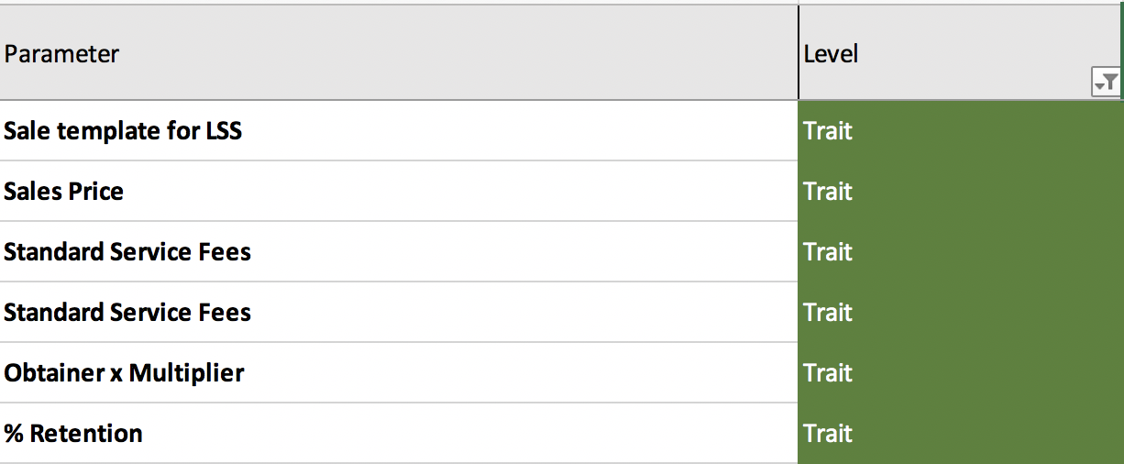
Master Data – System Parameters
TO-BE

Slide 16
Master Data – Commercial Hierarchy
TO-BE

Slide 17
Flow of permissions and contracts
Grower
User Profile 2
Trait
Sale
Consortium
User Profile 1
Finance
Custom User Profile1
Trait Owner
Marketing
Affiliate 1
Custom User Profile 2
Customer Care
Partner Head Office
Affiliate 2
Affiliate 3
Classify
Partner Companies
Back Office 1
Custom User Profile
We are assuming the Permissions Manager will be manager this users as well

Slide 18
Master Data – Single x Segregated Volume
TO-BE

Slide 19
Multiplication
Multi-Trait and Industry System Assessment

Slide 20




Multiplication
Prerequisites: Customer Master Data, Multiplication Contract, ITS User, Multiplication Parameters
Entered Area (EA)
EA Billing
EA Revenue
Approved Volume
Lots
Transfers
where the Mult. registers products, cooperators and their seed production areas
where the Mult. is billed for the seed production area (trait royalties)
Recognition
where the Multiplier requests approval for the commercial volume of seeds after harvest and beneficiation
where the Multiplier reports the lots (with quantity and WTS) that compose the Approved Volume
where the Multiplier transfers Approved Volume or Lots to another Multiplier
where the revenue of trait royalties (collected from Mult.) is recognized
AS IS
EA approval requests refer to products from the same Trait Owner
Billing is coupled with ITS and for only one trait
No automation provided by ITS
Volume Approval requests refer to products from the same Trait Owner
Lots refer to products of only one trait and from same Trait Owner
Transfer requests refer to products from the same Trait Owner
TO BE
EA validation requests will be submitted to the Commercial Hierarchy of the Consortium
Billing will be decoupled from ITS, so that ITS does not integrate directly with the Trait Owner’s ERP
No automation planned
Volume Approval requests will be submitted to the Commercial Hierarchy of the Consortium
Multiplier will need to register lots related to traits owned by multiple Trait Owners
Transfer requests will be submitted to the Commercial Hierarchy of the Consortium
Each trait owner will extract a billing report from its VC system and calculate / post the revenue recognition in its ERP
Each Trait Owner will trigger the billing for its own traits from its VC system
Overall assumption for the end state: Commercial Teams of the Trait Owner will not be users of the Industry System; they will access the data related to their traits through their Trait Owner Systems.

Slide 21
Sales
Multi-Trait and Industry System Assessment

Slide 22
Licensed Sales (1/2)
Prerequisites: Customer Master Data, Vendor Master Data (for Service Fee), Sales Contract, ITS User, Sales Parameters, Grower Master Data, GLA (Grower Licensing Agreement)
Cash Advance
Sale Registration
Quota
Quota Request (Poke)
Sales Validation
where the Multiplier pays in advance (with a special price) for the trait royalties related to seed sales
where the Multiplier or Dealer registers / edits / cancels a sale
where the system manages the balances of lots upon sale registration / edition / cancelation / adjustment
where the Multiplier or Dealer registers a request of missing quota that is blocking sale registration
where the Multiplier validates (monthly) all sales reported and the total amount of trait royalties to be billed
AS IS
No concept of trait / trait owner
Sales have only one trait and from the same Trait Owner
Quota refers to sales with only one trait and from the same Trait Owner
Quota Requests refer to sales with only one trait and from the same Trait Owner
One validation for all sales
TO BE
Cash Advance and Price Conditions will be decoupled from ITS (managed by the Trait Owner Systems).
Multiplier / Dealer will need to register sales with different traits in the same sale, from multiple Trait Owners.
Price conditions will not be selected per sale (upon sale registration).
Sales need to be accepted per item.
Multiplier / Dealer will need to view / search for quota of different traits, from multiple Trait Owners
Multiplier / Dealer will need to register quota requests for specific sale items Quota requests will be submitted to the Commercial Hierarchy of the Consortium
Multiplier will have to provide a specific validation for the sale items of each Trait Owner
The Industry System will provide to the multiplier the price conditions (per trait) available for selection for all those sales (based on an integration with each TOS). Price information must not be stored in the Industry System.
Overall assumption for the end state: Commercial Teams of the Trait Owner will not be users of the Industry System; they will access the data related to their traits through their Trait Owner Systems.
Notes:
Questions:
Sale Registration: Sales can be accepted per sale item?
Sales Validation: Is it necessary to be per trait?

Slide 23
Licensed Sales (2/2)
Prerequisites: Customer Master Data, Vendor Master Data (for Service Fee), Sales Contract, ITS User, Sales Parameters, Grower Master Data, GLA (Grower Licensing Agreement)
Licensed Sales Billing
Licensed Sales Revenue Recognition
Sale Adjustment
Service Fee (Sales)
Value Share
where the Multiplier is billed for the licensed seed sales (trait royalties)
where the Multi. edits a sale that was already billed (reports a volume increase or requests approval for a volume decrease – including returns)
where the Multiplier or Dealer receives a service fee for the data reported in the system
where the Obtainer receives an incentive proportional to the share of its germplasm within the trait’s market share
where the revenue of trait royalties (collected from Multipliers) is recognized
AS IS
Billing is coupled with ITS and for only one trait
RR is coupled with ITS and for only one trait
Sales have only one trait and from the same Trait Owner
No automation provided by ITS
Value Share Accrual is coupled with ITS and for only one trait
TO BE
Billing will be decoupled from ITS, so that ITS does not integrate directly with the Trait Owner’s ERP Each Trait Owner will trigger the billing for its own traits from its VC system
RR will be decoupled from ITS, so that ITS does not integrate directly with the Trait Owner’s ERP
Multiplier will need to adjust sales with different traits in the same sale, from multiple Trait Owners
Volume decrease requests will be submitted to the Commercial Hierarchy of the Consortium
The Trait Owner will need to manage the financial / monetary implication in their Trait Owner Systems
Calculation automation should be estimated.
Value Share Accrual (VSA) will be decoupled from ITS, so that ITS does not integrate directly with the Trait Owner’s ERP
In the meantime, the Consortium will extract a sales report from ITS and calculate / pay Multipliers / Dealers for their service
Each Trait Owner will trigger the RR for its own traits from its VC system
No RR data will be sent to ITS
Each Trait Owner will trigger the VSA for its own traits from its VC system
No VSA data will be sent to ITS
Minimum billing data (Yes/No and Payment Status) will be sent to ITS

Slide 24
(Agroeste) Branded Sales (1/2)
Prerequisites: Customer Master Data, Vendor Master Data (for Service Fee), Sales Contract, ITS User, Sales Parameters, Grower Master Data, GLA (Grower Licensing Agreement)
Multiplier Sale Registration
Multiplier Billing
Multiplier Revenue Recognition
Multiplier Sales Import
where the Trait Owner performs its billing
where the Trait Owner (TO) import branded sales from the Trait Owner`s ERP
where the Trait Owner registers / edits / cancels a registration
where the Trait Owner perform its revenue recognition
(@ Trait Owner’s ERP)
(@ Trait Owner’s ERP)
(@ Trait Owner’s ERP)
AS IS
Sales have only one trait
Sales have only one trait
Sales have only one trait
Sales have only one trait
TO BE
Branded Sales user will need to register sales with different traits in the same sale (but all from the same Trait Owner)
Note: some ERP configuration effort may be needed
No major change, aside from the fact that the sales will have more than one trait
Note: some ERP customization effort may be needed
No major change, aside from the fact that the sales will have more than one trait
Note: some ERP customization effort may be needed
Trait Owner user will need to import sales with different traits in the same sale, (but all from the same Trait Owner)
In the end state, Agroeste will have to operate as the Licensed Multipliers, so no customization will be needed in the Industry System.
The automated integration of Agroeste sales registered in Bayer’s ERP with the Industry System will have to be managed by Bayer´s Trait Owner System.
Overall assumption: Branded Sales will be a Bayer’s specific group of features, so they will not be offered to other Trait Owners.

Slide 25

(Agroeste) Branded Sales (2/2)
Prerequisites: Customer Master Data, Vendor Master Data (for Service Fee), Sales Contract, ITS User, Sales Parameters, Grower Master Data, GLA (Grower Licensing Agreement)
Dealer Sale Registration
Quota
Quota Request (Poke)
Multiplier Sale Adjustment
Service Fee (Sales)
where the system manages the balances of lots upon sale registration / edition / cancelation / adjustment
where the Multiplier or Dealer register a request of missing quota that is blocking sale registration
where the Dealer receives a service fee for the data reported in the system
where the Dealer registers / edits / cancels a sale
where the Trait Owner edits a sale that was already billed
(@ Trait Owner’s ERP)
AS IS
Sales have only one trait and from the same Trait Owner
Quota refers to sales with only one trait and from the same Trait Owner
Quota Requests refer to sales with only one trait and from the same Trait Owner
Not currently supported by ITS (workaround required)
No automation provided by ITS
TO BE
Same behavior as in Licensed Sale Registration
Same behavior as in Licensed Quota
Same behavior as in Licensed Quota Request
<Backlog – Sales Enhancements>
Same behavior as in Licensed Service Fee
In the end state, Agroeste will have to operate as the Licensed Multipliers, so no customization will be needed in the Industry System.
The automated integration of Agroeste sales registered in Bayer’s ERP with the Industry System will have to be managed by Bayer´s Trait Owner System.
Attention point for the fact that it is possible to have a dealer sale with branded and non-branded sale items
In the meantime, continue executing the workaround
Overall assumption: Branded Sales will be a Bayer’s specific group of features, so they will not be offered to other Trait Owners.

Slide 26
Demo Sales
Prerequisites: Customer Master Data, Vendor Master Data (for Service Fee), Sales Contract, ITS User, Sales Parameters, Grower Master Data, GLA (Grower Licensing Agreement)
Demo Quota Registration
Sale Registration
Quota
Quota Request (Poke)
where the Trait Owner registers the demo quota for each Obtainer / Multiplier
where the Multiplier / Dealer registers / edits / cancels a sale
where the system manages the balances of lots upon sale registration / edition / cancelation / adjustment
where the Multiplier or Dealer register a request of missing quota that is blocking sale registration
AS IS
Demo Quota has only one trait and from the same Trait Owner
Demo Sales have only one trait and from the same Trait Owner
Quota refers to sales with only one trait and from the same Trait Owner
Quota Requests refer to sales with only one trait and from the same Trait Owner
TO BE
Demo Quota will be decoupled from ITS, so that ITS does not need to care about that Each Trait Owner will decide if they will implement / use this feature, and they will need to manage it at their Trait Owner Systems
Similar behavior as in Licensed Sale Registration
Similar behavior as in Licensed Quota
Similar behavior as in Licensed Quota Request
In the end state, there will be no longer a specific sale type for Demo.
The partners will have to register these sales using Regular sale type, but they will also have to report the CFOP (Fiscal Operational Code).
Based on the CFOP, the Trait Owners (in their Trait Owner Systems) will determine if the sale needs to be billed or not (eg: if the CFOP is related to Demo and the partner still has available Demo Quota, the sale will not be billed).

Slide 27
Seed Production Sales
Prerequisites: Customer Master Data, Vendor Master Data (for Service Fee), Sales Contract, ITS User, Sales Parameters, Grower Master Data, GLA (Grower Licensing Agreement)
Sale Registration
Quota
where the Multiplier registers / edits / cancels a sale
where the system manages the balances of lots upon sale registration / edition / cancelation / adjustment
AS IS
Seed Production Sales have only one trait and from the same Trait Owner
Quota refers to sales with only one trait and from the same Trait Owner
TO BE
Similar behavior as in Licensed Sale Registration
Similar behavior as in Licensed Quota
In the end state, there will be no longer a specific sale type for Seed Production.
The partners will have to register these sales using Regular sale type, but they will also have to report the CFOP (Fiscal Operational Code).
Based on the CFOP, the Trait Owners (in their Trait Owner Systems) will determine if the sale needs to be billed or not (eg: if the CFOP is related to Seed Production, the sale will not be billed).

Slide 28
POD (Point of Delivery)
Multi-Trait and Industry System Assessment

Slide 29
POD (1/2)
Prerequisites: Customer Master Data, Vendor Master Data (for Service Fee), POD Contract, ITS User, Sales Parameters (eg: plantability), POD Parameters, Grower Master Data, GLA (Grower Licensing Agreement)
Grain Receival
CE Generation (back-end)
CE Consumption
CE Manual Generation / Negative Adjustment
CE Transfer
where the POD reports the loads / trucks of grains received from Growers
where the system generates Credit Exemption (CE) for Growers based on transactions from other modules
where the POD registers the consumption of CE
where the back office User registers transfers of CE (from a grower to another)
where the back office User registers manual generation / negative adjustment of CE
AS IS
Not supported by ITS
CE is generated per trait (segmented volume) based on standard parameters
CE is consumed per trait (segmented volume)
CE is adjusted per trait (segmented volume)
CE is adjusted per trait (segmented volume)
TO BE
The POD Detailed Model will enable the collection of this data from PODs through a B2B service / integration.
Single volume: CE is generated as a virtual “single volume” trait, same calculation formula, but some parameter values vary per trait
Single volume: CE is consumed from the virtual “single volume” trait
Single volume: CE is adjusted from the virtual “single volume” trait
Only Consortium Users can adjust CE related to “single volume”
Depending on the case, the Consortium may need inputs from the Trait Owner before approving this transaction.
Single volume: CE is transferred from the virtual “single volume” trait
Only Consortium Users can transfer CE related to “single volume”
Depending on the case, the Consortium may need inputs from the Trait Owner before approving this transaction.

Slide 30
POD (2/2)
Prerequisites: Customer Master Data, Vendor Master Data (for Service Fee), POD Contract, ITS User, Sales Parameters (eg: plantability), POD Parameters, Grower Master Data, GLA (Grower Licensing Agreement)
ROL
POD Billing
POD Revenue Recognition
ROL Adjustment
Service Fee (POD)
Season Closing
where the POD registers the data needed for billing (fixed volume with no CE) and service fee calculation
where the POD is billed for the Growers` fixed volume with no CE (trait royalties)
where the POD edits a ROL that was already billed (reports a fixed volume increase or requests approval for a fixed volume decrease)
where the POD receives a service fee for the data reported in the system
where the POD registers the growers with grain volumes not yet fixed from previous seasons
where the revenue of trait royalties (collected from PODs) is recognized
AS IS
ROL per trait (segmented volume)
Billing is coupled with ITS and for only one trait
RR is coupled with ITS and for only one trait
ROLs have only one trait and from the same Trait Owner
Service Fee is coupled with ITS and for only one trait
Season Closing per trait (segmented volume)
TO BE
Single volume: ROL is reported for the virtual “single volume” trait
Only Consortium Users can approve ROLs
The 3 reporting models (consolidated, partial and detailed) will still exist
Billing will continue being part of ITS, as the Consortium will be responsible for collecting this revenue from the PODs.
RR will be totally decoupled from ITS, so that ITS does not integrate directly with the Trait Owner’s ERP
Single volume: ROL is adjusted for the virtual “single volume” trait
Only Consortium Users can approve ROL Adjustments
Service Fee Calculation will continue being part of ITS, as the Consortium will be responsible for paying it to the PODs.
Single volume: Season Closing (SC) is reported for the virtual “single volume” trait
Only Consortium Users can approve Season Closing reports
Each Trait Owner will trigger the RR for its own traits from its VC system
No RR data will be sent to ITS
Service Fee Payment will be processed by the Consortium’s ERP

Slide 31
Legally Saved Seeds
Multi-Trait and Industry System Assessment

Slide 32
Legally Saved Seeds
Prerequisites: Customer Master Data, ITS User, LSS Parameters, Sales Parameters, Grower Master Data, GLA (Grower Licensing Agreement)
LSS Sale Registration
LSS Bank Slip Generation
LSS Payment
LSS Revenue Recognition
Service Fee (LSS)
where the User register / cancel a LSS sale and issues a bank slip to a grower
where the Accounts Receivable User updates the payment status of a LSS sale
where the revenue of trait royalties (collected from Growers) is recognized
where the Multiplier or Dealer receives a service fee for the data reported in the system
where ITS integrates with the bank and generates a bank slip to be paid by the Grower
AS IS
LSS Sales have only one trait and from the same Trait Owner
LSS Bank Slip for only one trait and from the same Trait Owner
LSS Payments refer to only one trait and from the same Trait Owner
RR is coupled with ITS and for only one trait
No automation provided by ITS
TO BE
User will need to register LSS sales with different traits in the same sale, from multiple Trait Owners
One LSS Bank Slip issued by the Consortium considering all traits
Accounts Receivable users from the Consortium will update LSS payments
RR will be totally decoupled from ITS, so that ITS does not integrate directly with the Trait Owner’s ERP
Calculation automation should be estimated.
The Consortium will then later distribute the received value among the Trait Owners (this will be in the scope of the Consortium’s ERP)
Each Trait Owner will trigger the RR for its own traits from its VC system
No RR data will be sent to ITS
In the meantime, the Consortium will extract a LSS sales report from ITS and calculate / pay Multipliers / Dealers for their service
Automation alternatives should be considered
LSS registration requests must be submitted to the Consortium for approval (to prevent fraud)

Slide 33

Backup Slides
Additional Information

Slide 34
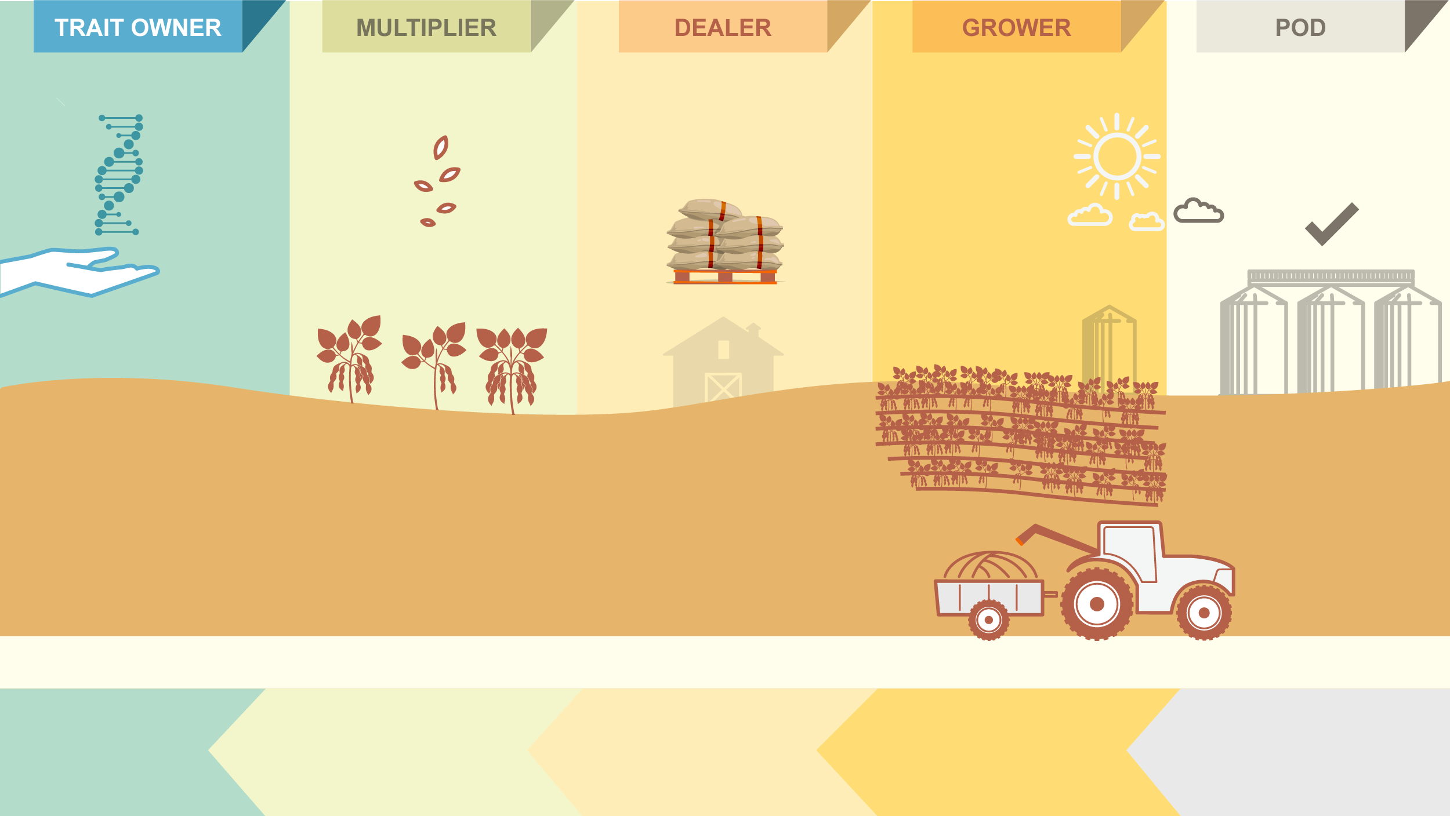

VALUE
Trait R&D
Seed Production
Seed Sales
Grain Production
Grain Receiving
Certified
Seeds
Saved Seeds
Trait
License
Certified
Seeds
The system enables Trait Owners* to collect revenue related to intellectual property rights in countries where growers are allowed to save seeds.
Grains
CAPTURE
* Currently only Bayer, but the vision is to become an Industry System (serving other Trait Owners).
Value Capture System Core Modules
Revenue over Multiplication
Revenue over Seed Sales
Revenue over
Legally Saved Seeds
Revenue over POD
(Illegally Saved Seeds)

